Slide 1

HBV Team - 02/02/2024 Dwiva Anbiya Taruna - 5849578 Konstantina Bourazani - 5728347 Hang Long - 5743702 Thomas Poort - 4715500
Uncertainty Estimation in Discharge Forecasting

Slide 2
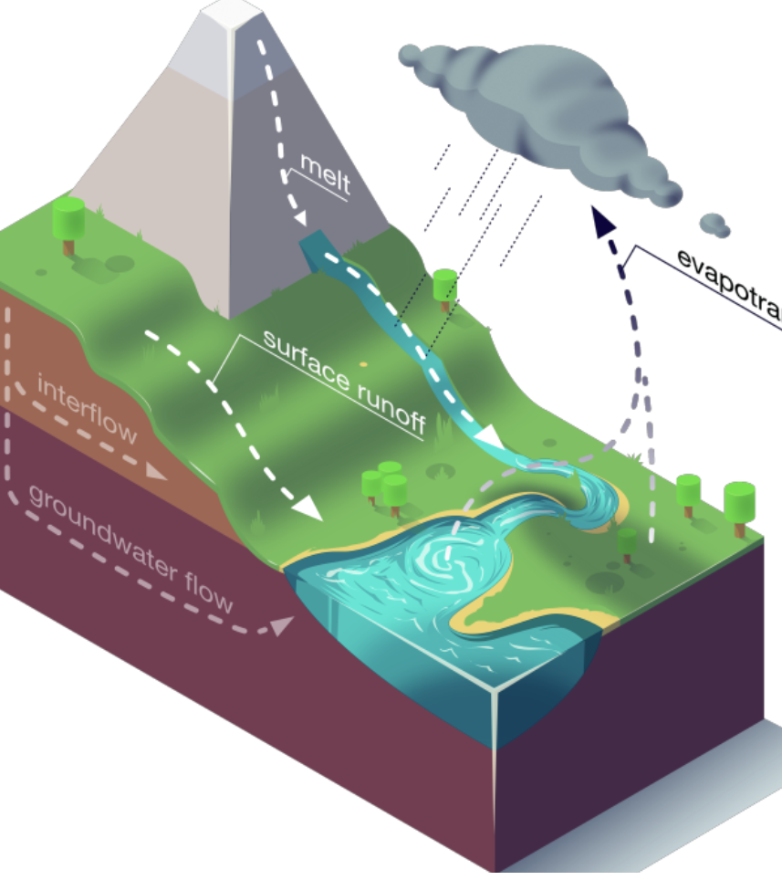
Rainfall – Runoff
Rainfall-runoff:
process by which precipitation interacts with the Earth’s surface, leading to runoff / discharge.
Influencing factors:
Water flows: Precipitation, infiltration, evaporation, snowmelt
Land use
Soil type
Topography
Etc.
Rainfall-runoff is a crucial component of the hydrological cycle.
Source: https://neuralhydrology.github.io/post/research/lees2021concept/

Slide 3
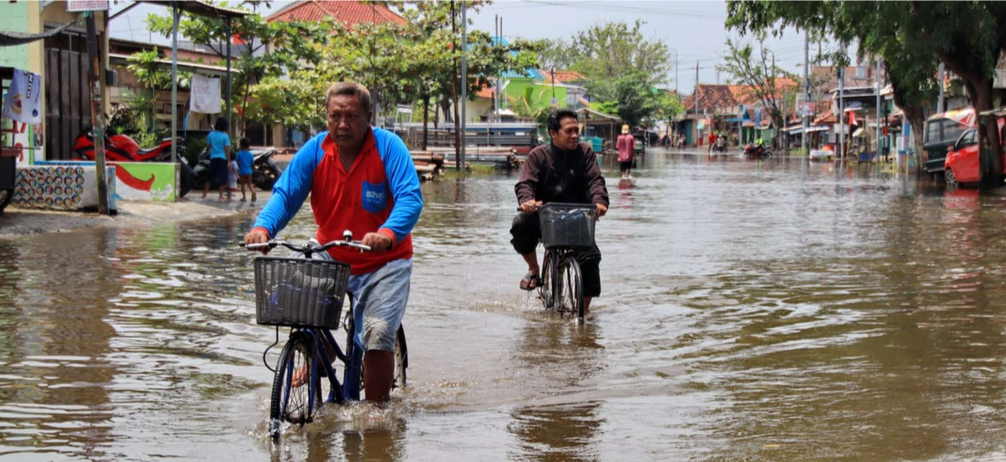
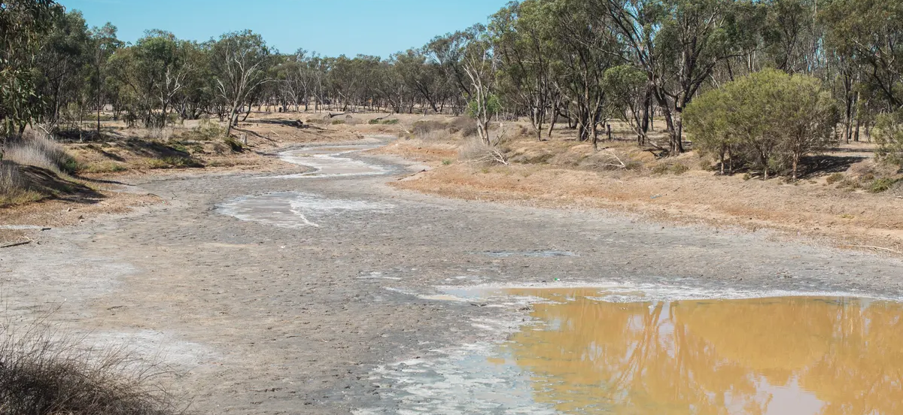
Significance of Modeling Rainfall-Runoff
Risk mitigation and public safety
Infrastructure protection
Optimal water resource management
Especially now in times of climate change, leading to more floods/droughts
Notes:
Discharge refers to the volume of water that flows through a river or stream over a given period.
Now accuracy in discharge forecasting can be crucial especially when it comes to high volumes of water so like for predicting flooding events and issuing evacuation plans, protecting critical infrastructure such as bridges and damns,
But also in less critical instances like precisely predicting water availability to optimize water management.

Slide 4
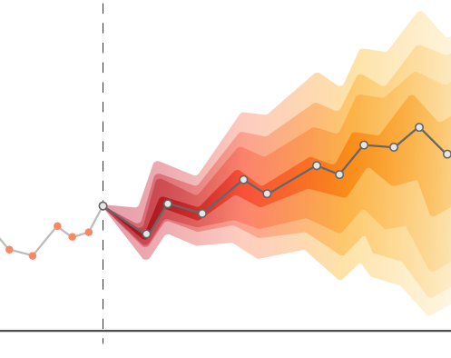
Need for probabilistic predictions
At present, models are only used for deterministic results
Probabilistic models provide uncertainty quantification, important for:
Risk assessment
Decision making
Water allocation
Climate Change adaptation

Slide 5
Problem statement:
Bridge the gap in uncertainty estimations in hydrological predictions

Slide 6
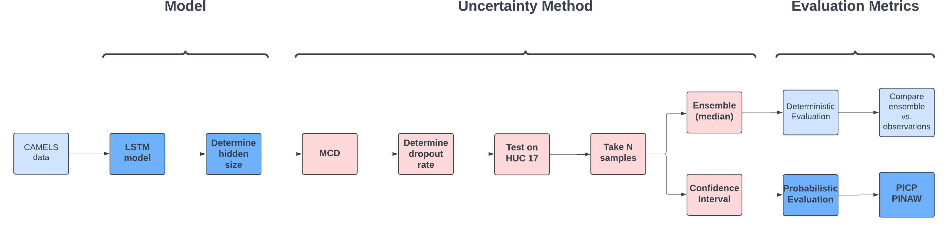
Objectives/Workplan
Main objectives:
Uncertainty estimation for discharge
Exploration for evaluation metrics
Investigation on transferability of model
Notes:
The main objectives
Uncertainty estimation for discharge
Exploration for evaluation metrics either its deterministic evaluation or probabilistic evaluation
Investigation on transferability
For the workplan
Use the CAMELS data, selecting the base model which in this case use LSTM by defining the optimal hidden size
Implement the monte carlo dropout to the base model, by varying the dropout rate to get the optimal monte carlo, and we do test to selected HUC17
Determine the n samples
When it comes to evaluation we use the median as ensemble of model to evaluate with deterministic evaluation, and use the confidence interval to do the probabilistic evaluation for PICP and PINAW

Slide 7
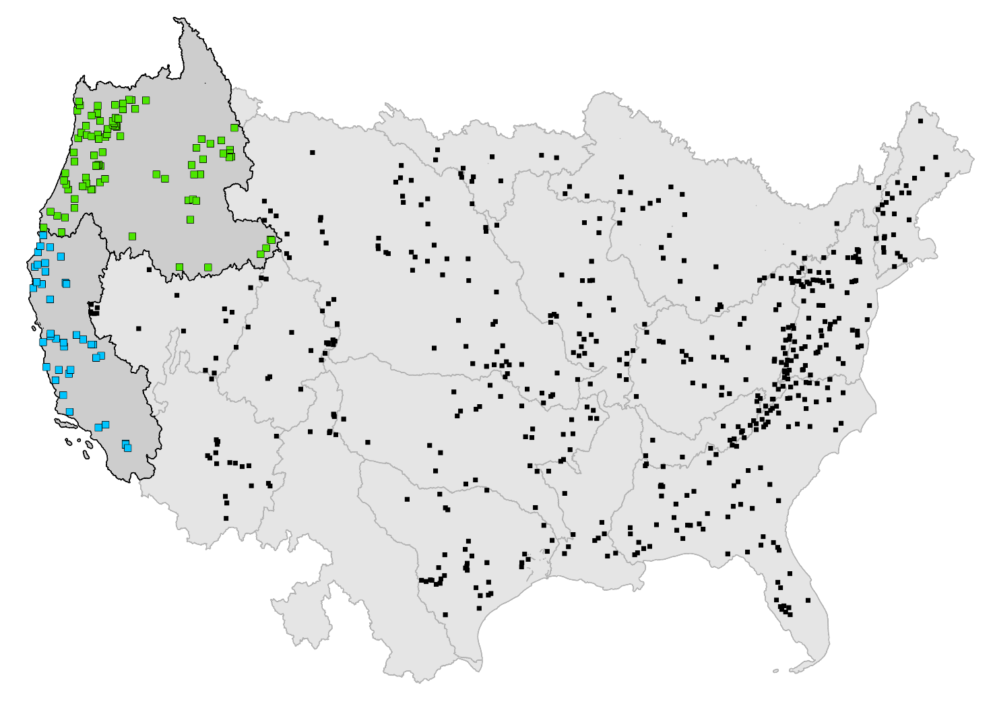
Data
HUC 17
Contains data for 671 USA basins:
Meteorological time-series data
Streamflow data
Basin attributes
For this project we selected HUC 17 for our model and used HUC 18 for Transfer Learning
HUC 18
Basin
Hydrologic Unit Code (HUC)
Notes:
HUC 17 as training set, validation set, test set
HUC 18 as test set
# Forcing product [daymet, maurer, maurer_extended, nldas, nldas_extended, nldas_hourly]# can be either a list of forcings or a single forcing productforcings: - maurer - daymet - nldasdynamic_inputs: - PRCP(mm/day)_nldas - PRCP(mm/day)_maurer - prcp(mm/day)_daymet - srad(W/m2)_daymet - tmax(C)_daymet - tmin(C)_daymet - vp(Pa)_daymet# which columns to use as targettarget_variables: - QObs(mm/d)# clip negative predictions to zero for all variables listed below. Should be a list, even for single variables.clip_targets_to_zero: - QObs(mm/d)static_attributes: - elev_mean - slope_mean - area_gages2 - frac_forest - lai_max - lai_diff - gvf_max - gvf_diff - soil_depth_pelletier - soil_depth_statsgo - soil_porosity - soil_conductivity - max_water_content - sand_frac - silt_frac - clay_frac - carbonate_rocks_frac - geol_permeability - p_mean - pet_mean - aridity - frac_snow - high_prec_freq - high_prec_dur - low_prec_freq - low_prec_dur

Slide 8
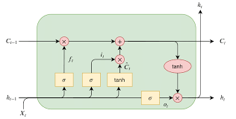
Long Short-Term Memory (LSTM) Model
Input:
Forcing data
Basin attributes
LSTM networks have shown significant promise in the field of hydrology
They can capture temporal dependencies
They have memory cells that can retain information over extended periods
Chosen LSTM -> 250 hidden size
Output:
Discharge prediction
Notes:
In this project, we are going to be using a lstm network to make our discharge predictions. In the field of hydrology, capturing temporal dependencies like the ones that exist in discharge measurements is very important and lstm networks are able to do this. By using the memory cells that they have, they can retain information over extended periods of time

Slide 9
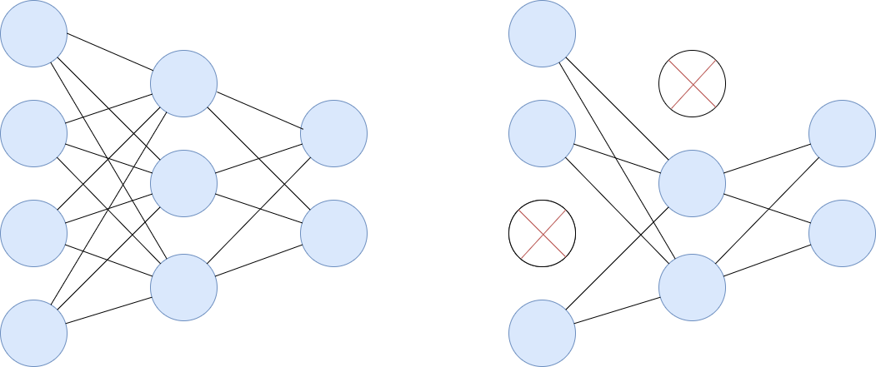
Monte Carlo Dropout (MCD)
For chosen LSTM model, MCD was used:
Provides uncertainty estimation by taking N samples
Regularization technique, preventing overfitting
Allows for creating an ensemble
Number of samples -> 1000
Dropout rate -> 0.2, 0.3, 0.4, 0.5

Slide 10
Evaluation Metrics
Deterministic:
NSE, MSE, RMSE, KGE
Probabilistic:
PICP -> Reliability
PINAW -> Informativeness

Slide 11
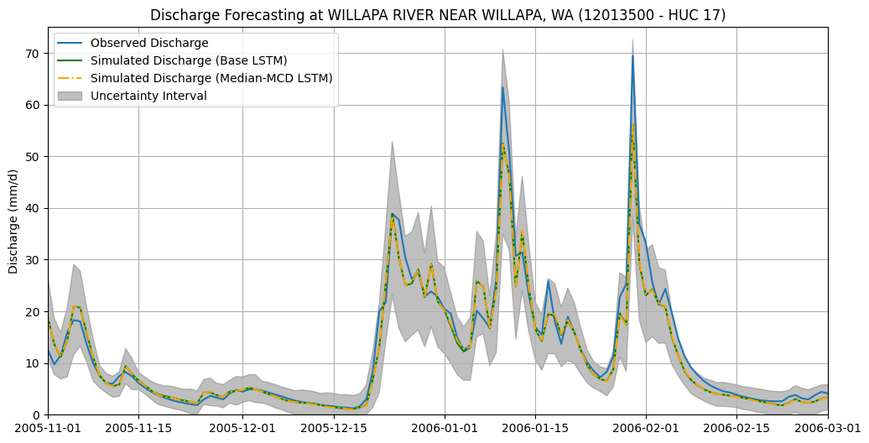
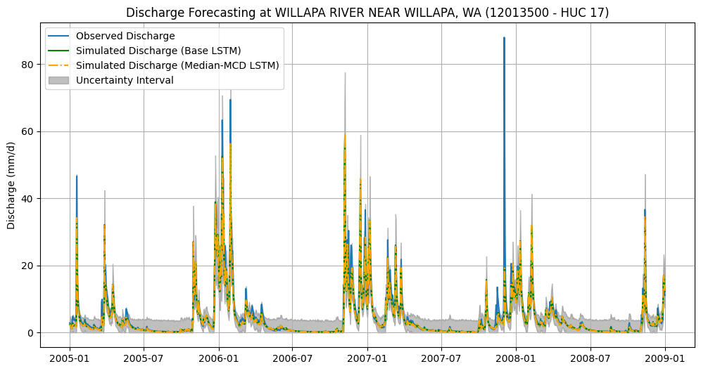
Results 1: Discharge Forecasting
NSE: 0.86
PICP: 95.48
PINAW: 0.75
Notes:
So, these are our results for our simulation. We selected a basin which had a good PICP and NSE score and as can be seen, the simulations from the monte carlo and lstm are really similar and also match the observations. We zoomed in on a specific high discharge event to see if the peaks are capturerd by our model. Uncertainty interval for higher discharge is larger.

Slide 12
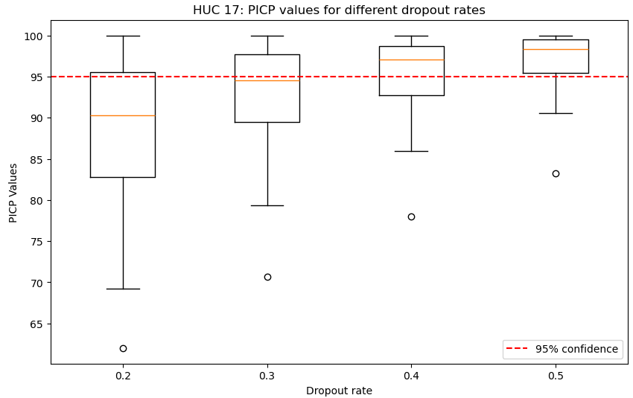
Result 2: Uncertainty analysis
The desired dropout rate was determined
Based on the 95% confidence interval -> dropout rate 0.4
MC dropout rate | Median PICP | Median PINAW
0.2 | 90.28 | 0.7
0.3 | 94.5 | 0.89
0.4 | 97 | 1.09
0.5 | 98.4 | 1.31
Notes:
Explain box plot , 91 basins in single box plot
Increase of propout rate better coverage

Slide 13
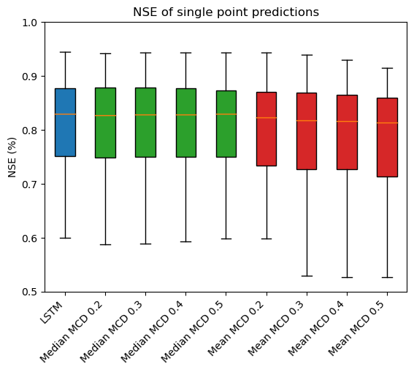
Result 3: Single point prediction
Median of MCD is equivalent to LSTM prediction
Mean of MCD performs worse than LSTM predictions
Correlation | Median MCD | Mean MCD
Dropout rate = 0.2 | 0.9911 | 0.6315
Dropout rate = 0.3 | 0.9938 | 0.4988
Dropout rate = 0.4 | 0.9951 | 0.4342
Dropout rate = 0.5 | 0.9928 | 0.3978
Notes:
Single point doesn’t affect the result so stick to 0.4
Median prediction accuracy independent from dropout rate.
If we use median, whaterver the dropout rate is we can see its similar to LSTM
But with mean the situation is different.

Slide 14
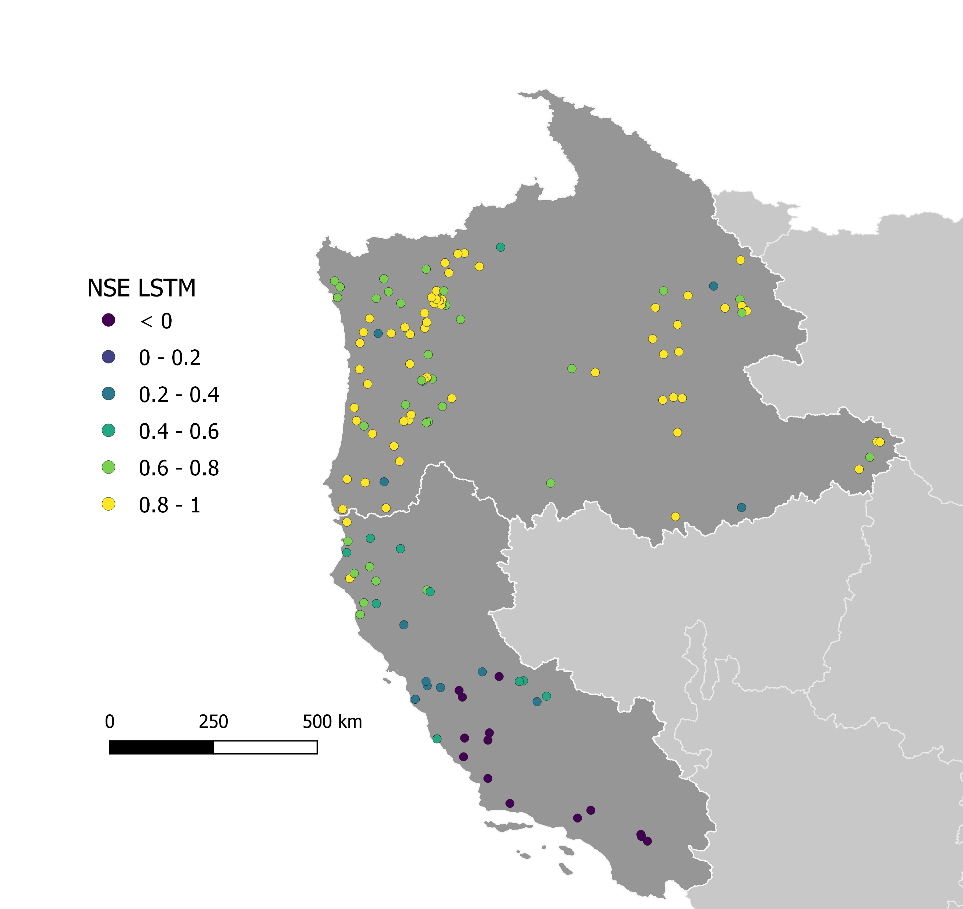
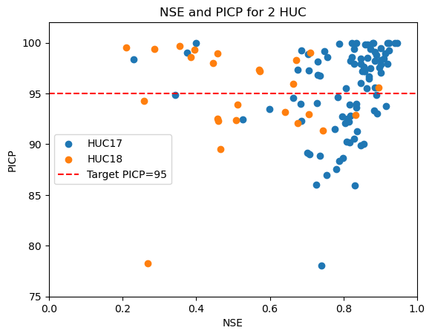
Result 4: Transferability
MC dropout rate = 0.4
HUC 17
HUC 18

Slide 15
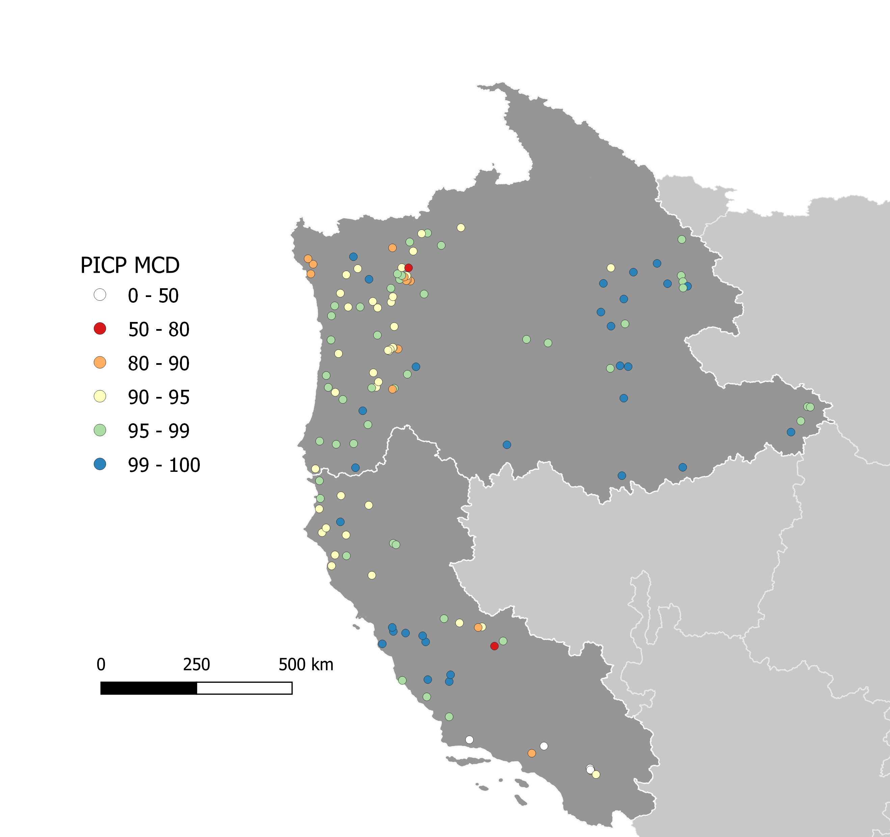
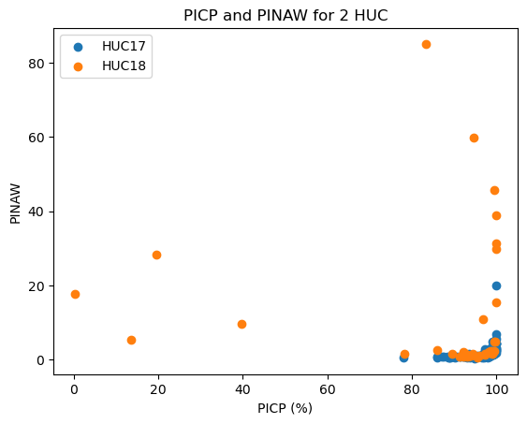
Result 4: Transferability
Reliable
Not informative
HUC 17
Informative
Not reliable
HUC 18
Optimal
Notes:
We can say the PICP has a better transferability based on our plot, since it remains the same for HUC 18 but the NSE is significantly lower. However, when we compare with the other metric, the PINAW
A lot high reliability and a rather small confidence interval,
The width is so big that it is not reliable anymore --> blue
And we have a few outliars with a low PICP and a good PINAW score, if we would have more time it would be interesting to explore why that happens in that region.

Slide 16
Conclusion
LSTM hidden size should be large enough to implement MCD
MCD produces reliable confidence interval when dr > 0.4
Median MCD prediction is equivalent to LSTM (independent from dr)
MCD tends to be not informative when applying to another HUC
It is difficult to evaluate MCD with PICP and PINAW. A unified metric is needed

Slide 17
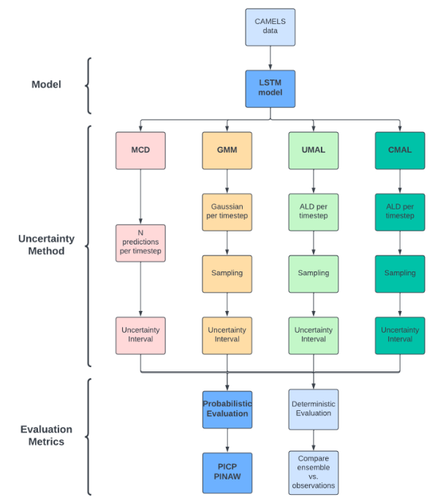
Reflection
Our original plan was to use three forms of Mixture Density Networks as well
If we have more time, we will probably look into why MCD shows different 'behaviors' when applying HUC 18

Slide 18
Thank you for your attention
HBV Team

Slide 19

Logbook

Slide 20
Draft Outline
Introduction: Explain the basic rainfall runoff model and bridging to uncertainty estimation for discharge forecasting, deterministic vs probabilistic forecasting
Methods / Experiments:
Uncertainty model – probabilistic evaluation metrics (PINAW, PICP)
LSTM Base model vs single point prediction (mean and median from uncertainty model) – deterministic evaluation metrics (NSE, etc)
Transferability – test to another basin in different HUC – comparing before after performance of model, introduce the importance to use in ungauged basin
Results
Conclusion
Reflection
10-12 slides
15 mins presentation time, 10 mins Q&A

Slide 21
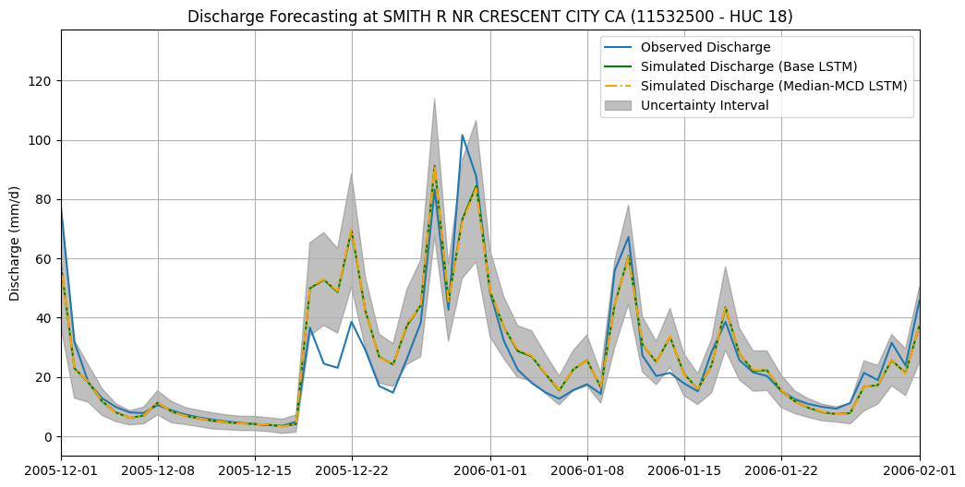
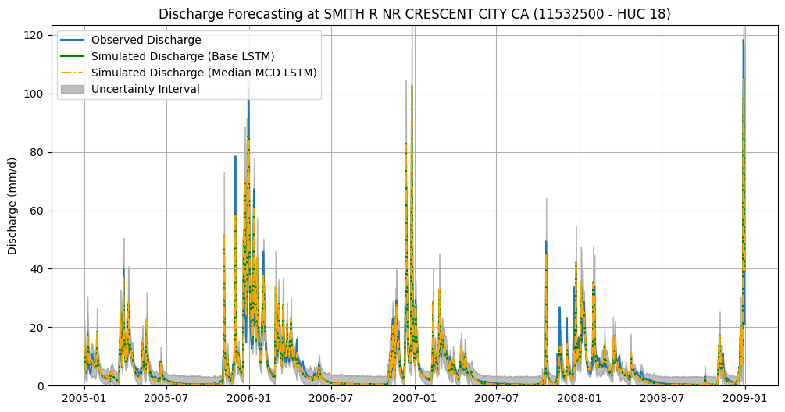
HUC 18 Results

Slide 22
Main objectives
Uncertainty estimation for discharge prediction
Exploration of evaluation metrics
Investigate a methodology for uncertainty estimation in discharge prediction using machine learning model.
Explore suitable metrics for evaluating the performance of the uncertainty estimation method used.
Notes:
The way we are going to go forward with this is that we have two main objectives: gain experience in discharge prediction using LSTM networks
Use different methodologies for uncertainty estimation using machine learning models
And finally explore suitable metrics to evaluate the performance of the models.

Slide 23
